Slide 1


Gesture Controlled Robot
By,
Laxuman Pradhan (20120144)
Aiman Jalil (20120308)
Ashwin Bordoloi(20120392)
Under the guidance of
Mr. Saurav Paul
(Assistant Professor I ,SMIT)
SIKKIM MANIPAL INSTITUTE OF TECHNOLOGY
MAJITAR RANGPO, EAST SIKKIM 737136
11/12/2015
14

Slide 2
CONTENTS
ABSTRACT
INTRODUCTION
LITERATURE SURVEY
PROBLEM DEFINITION
SOLUTION STRATEGY
DESIGN: FLOWCHART
IMPLEMENTATION
RESULTS AND DISCUSSIONS
GANTT. CHART
REFERENCES
13

Slide 3
ABSTRACT
Limit the usage of peripheral devices.
This can be done by interpreting hand gestures.
Recognize patterns, generate movements.
Give output to the robot.
Perform action.
12

Slide 4
INTRODUCTION
Use of gestures to provide a more natural way of controlling robotic systems
Passage of data signals to robot using either an accelerometer or via image processing
Program compiled using an Arduino microcontroller
Image processed using MATLAB
11

Slide 5
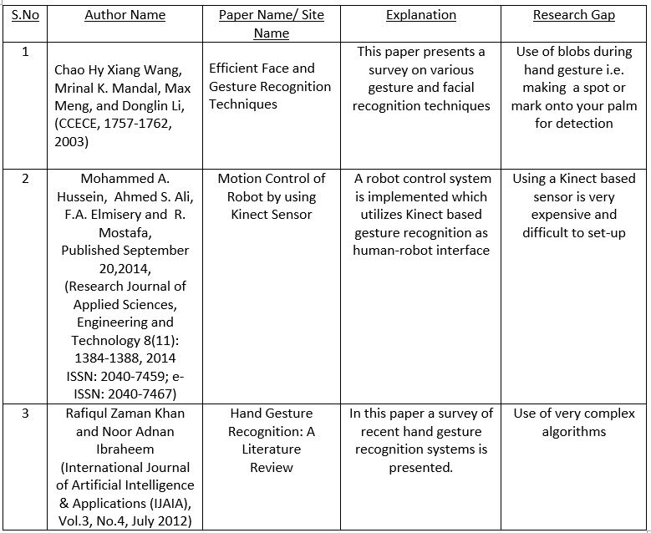
LITERATURE SURVEY
10

Slide 6
PROBLEM DEFINITION
High Cost of peripherals, associated with control of the Robot.
Maintaining a background database .
Hand gesture recognition using hand accessories/props .
9

Slide 7
SOLUTION STRATEGY
Capture images of gestures
Process Gesture input
Command Signal Generation
Navigation of Robot in specified direction
Passing Signal to Robot
Basic control flow of the system
8

Slide 8
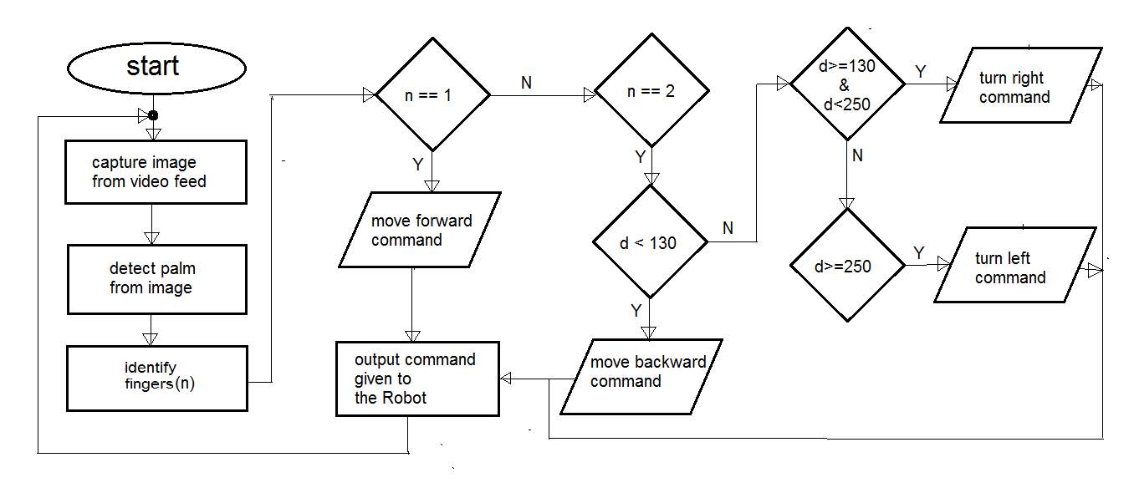
DESIGN: FLOWCHART
7

Slide 9
IMPLEMENTATION DETAILS
Image Processing : Using MATLAB 2013a
Skin Detection for detecting palm
Finger Count by segregating connected components.
Calculating Distance to identify Gesture
Robotics : Using Arduino UNO R3 Microcontroller
Embedded C to program Robot
USB Serial Connection to send Commands
6

Slide 10
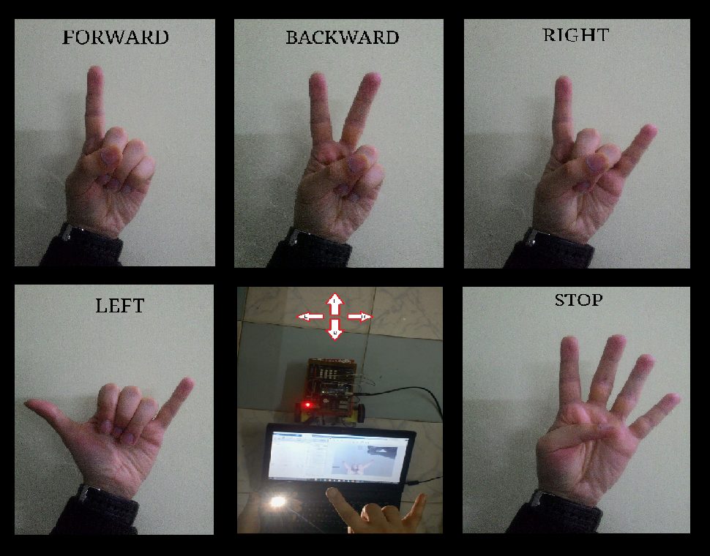
GESTURE COMMANDS
5

Slide 11
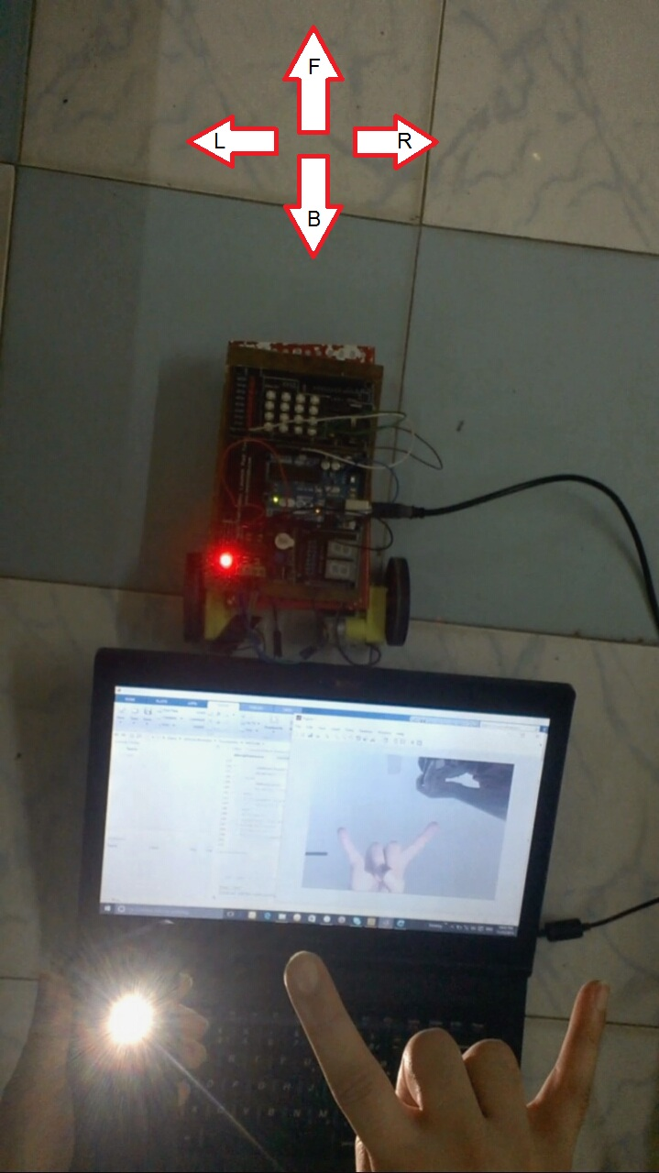
RESULTS AND DISCUSSIONS
Implemented System is cost effective. Only an ordinary WEBCAM used.
No databases were maintained. Completely based on Live video feed.
No Accessories were used with the gestures. Gesture input purely based on Skin Detection.
4

Slide 12
LIMITATIONS
Requires Uniform lighting in the background.
Presence of Other skin elements interferes with Gesture Recognition
Wired input to the Robot limits its movement space
3

Slide 13
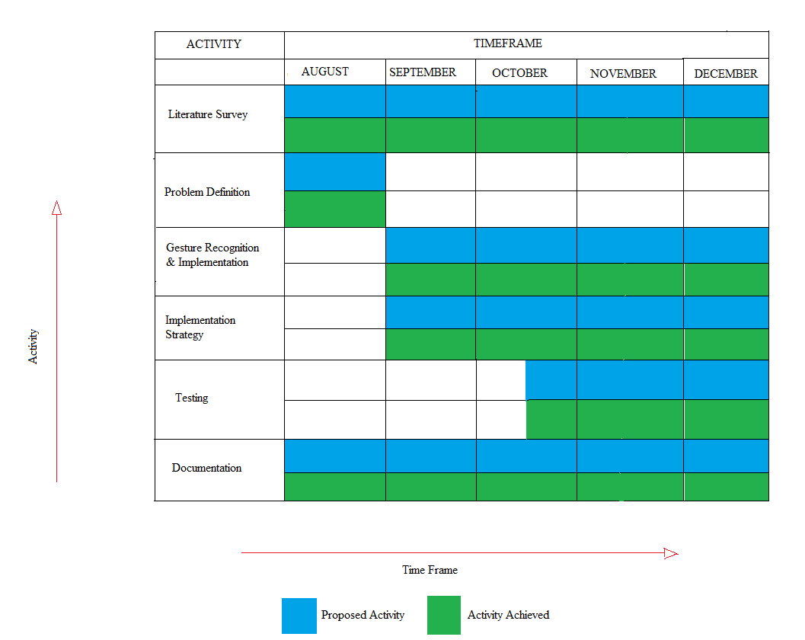
GANTT CHART
2

Slide 14
REFERENCES
Motion Control of Robot by using Kinect Sensor- Paper by Mohammed A. Hussein, Ahmed S. Ali, F.A. Elmisery and R. Mostafa, September 2014
Hand Gesture Recognition: A Literature Review- Paper by Rafiqul Zaman Khan and Noor Adnan Ibraheem, July 2012
Efficient Face and Gesture Recognition Techniques- Paper by Chao Hy Xiang Wang, Mrinal K. Mandal, Max Meng, and Donglin Li, CCECE, 1757-1762, 2003
Arduino: http://www.arduino.cc/en/Guide/HomePage
AdruinoUno, http://arduino.cc/en/Main/arduinoBoardUno.
http://www.e-yantra.org/home/projects-wiki/item/180-gesture-controlled-robot-using-firebirdv-and-kinect
http://luckylarry.co.uk/arduino-projects/control-a-dc-motor-with-arduino-and-l293d-chip/
1

